Slide 1
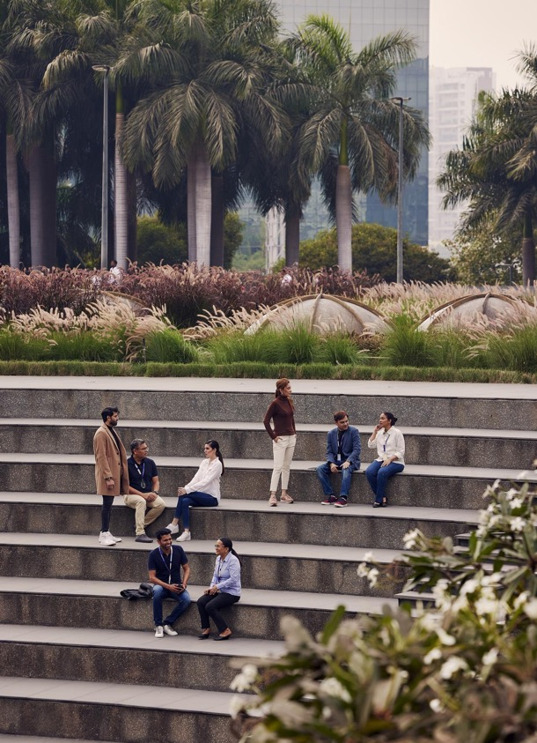
Your digital identity
How to impress your future employer
19 September 2024
Jonas Ekerhovd @ITxBergen
Notes:
Show of hands: English speakers?

Slide 2
Agenda
Tietoevry Presentation
Speaker Presentation
Warm-up exercise (5min)
The importance of visibility
Exercise 1: SSI Index (5 min)
Why?
Exercise 2: Github Readme (20min)
Exercise 3: Github Pages w/ Jekyll (20min)
Notes:
Det er ikke nødvendig å bli ferdig i løpet av økten, men det er en kickstart for å komme i gang. Jeg håper å vise hvor nyttig og kraftig verktøy det kan være å jobbe med din digitale profil
Under øvelsene så kommer jeg til å ha follow a-long live på skjermen.
Spørsmål er velkomne underveis. Hvis dere skulle komme opp med noen spørsmål i ettertid, legg meg til på LinkedIn og spør meg der når som helst! QR kode kommer på slutten.

Slide 3
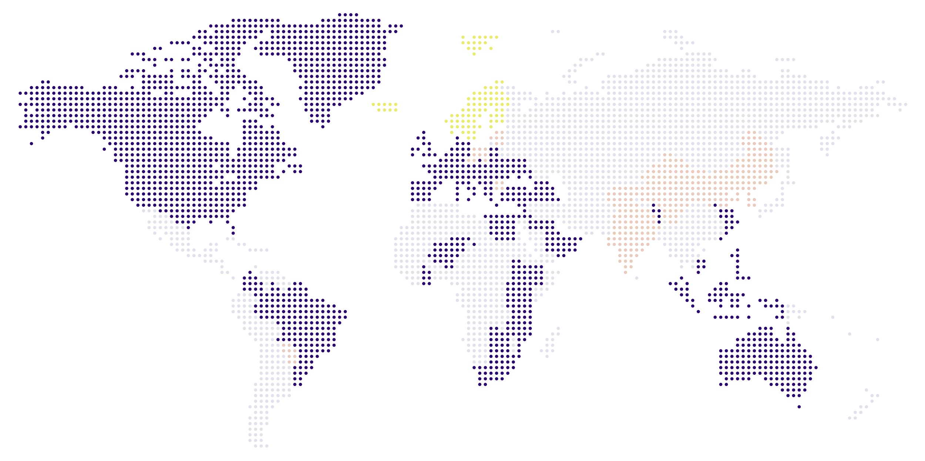
We are developers of digital futures
Global competence centres
Customer deliveries
The Nordics
Over 24 000
professionals globally
Approximately 10 000 customers
Serving customers in approximately 90 countries worldwide
Annual revenue around EUR 3 billion
Notes:
Hand raise: How many of you have heard of Tietoevry?

Slide 4
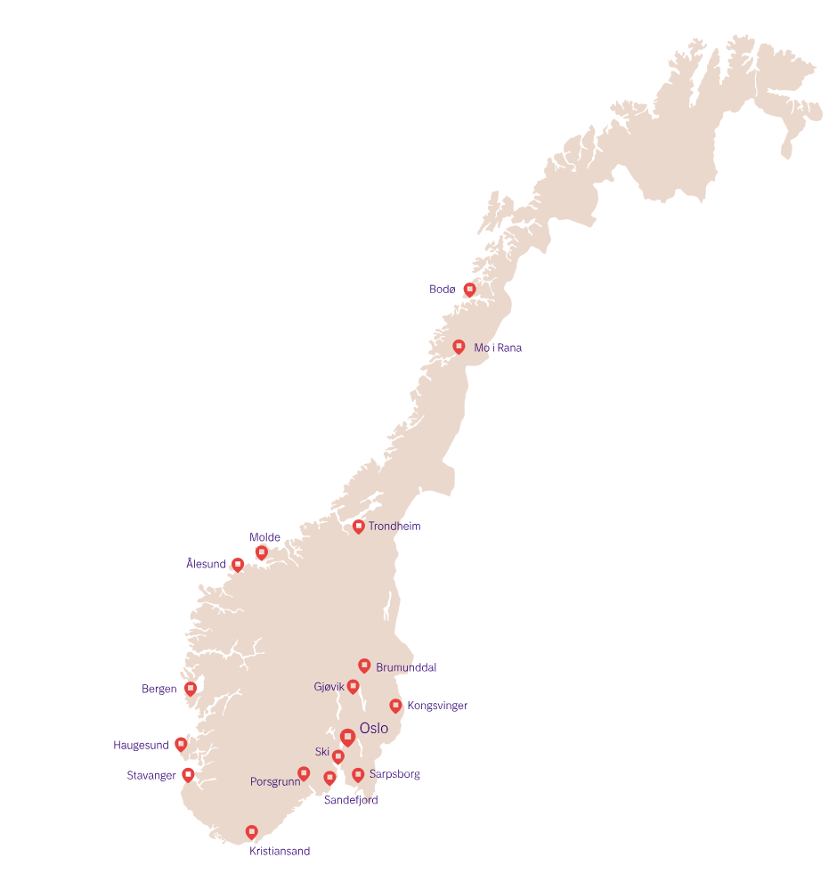
Tietoevry Norway
17 offices
4000 employees
Main customer segments:
Public & Healthcare
Industry
Financial Services
Retail and Consumer Services

Slide 5
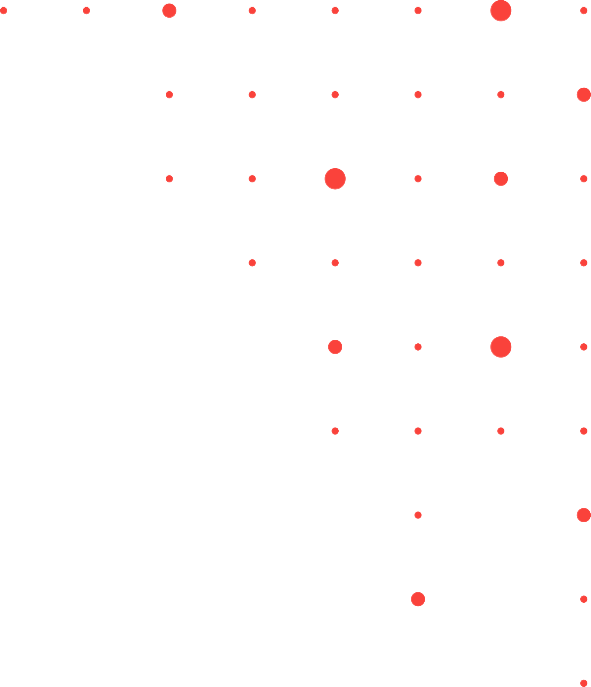
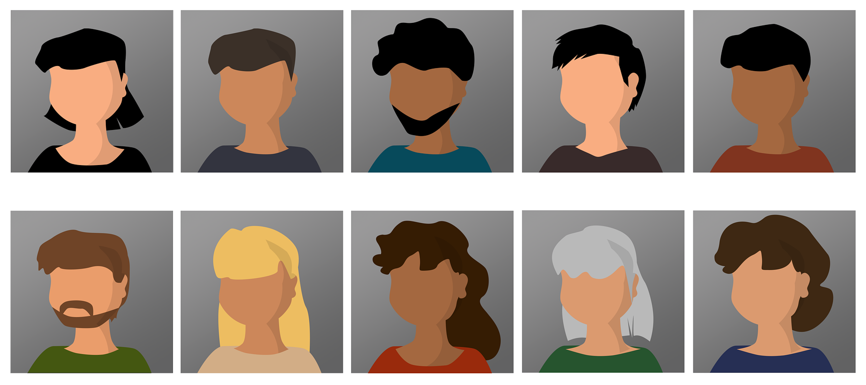
We are hiring for many different roles. Do you see something that suits you?
UX designer
Security Consultant
Project Manager
Infrastructure Architect
Data Scientist
Software Developer
Technical Specialist
Solution Consultant
Solution Architect
Product owner

Slide 6
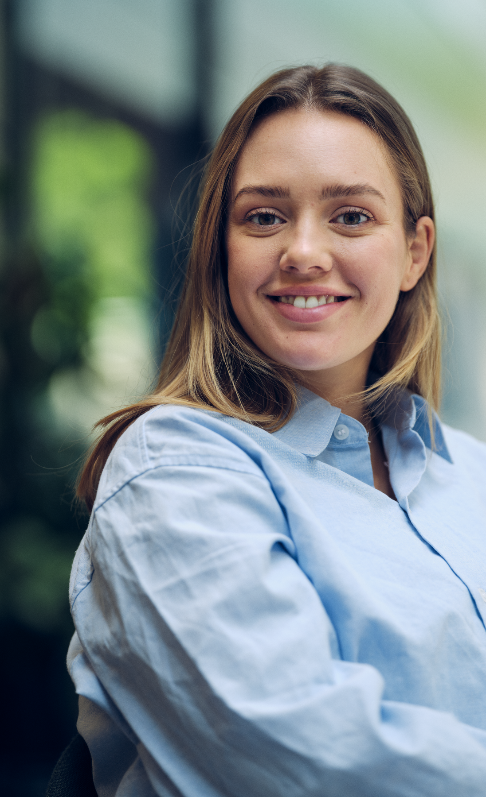
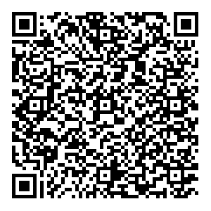

Graduate program Graduating in 2025? 🧑‍🎓 Join the largest IT consultancy company in the Nordics 🚀 Locations: Bergen, Trondheim, Stavanger, and Oslo 📍 Application deadline: October 28 ⏰
6

Slide 7
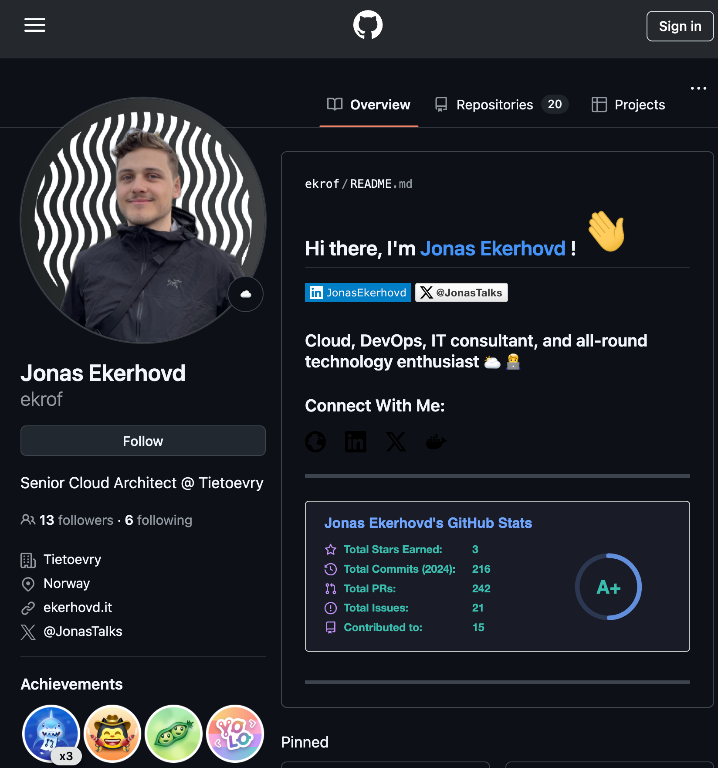
Whoami?
Senior Cloud Architect ☁ @ Tietoevry
Worked at Tietoevry for the past 3️⃣ years
Likes to 🏃, 🚴‍♀️ and 🏋️‍♀️
Just became a dad 👶🏻

Slide 8

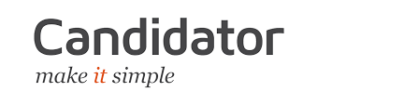


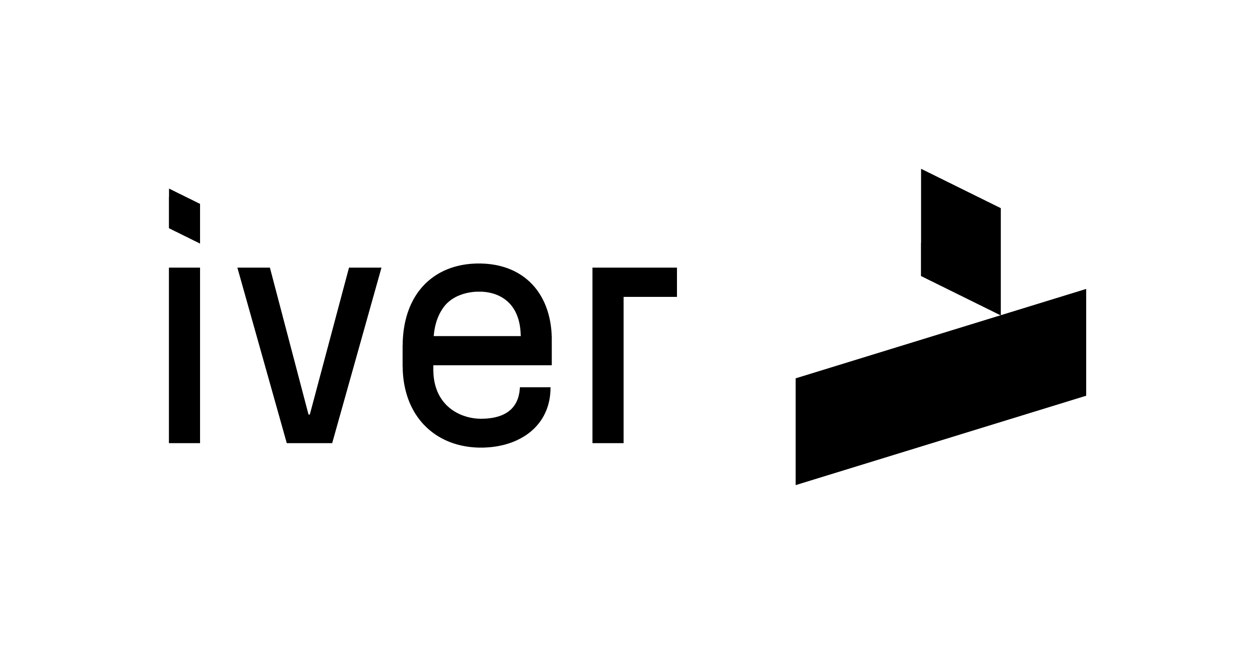

Notes:
Before that, I worked here (Candidator/Iver), and here (Microsky/Arribatec). Before that, I attended this very conference myself when I was studying IT at HVL.

Slide 9
By the end of this
You won’t just impress employers; you’ll make them Google you twice.

Slide 10

Warm-up Exercise (5 mins)
Google Yourself (No, seriously)
Notes:
Hva ser du? Det samme ser dine fremtidige arbeidsgivere når du søker jobb hos dem.
Incognito mode

Slide 11
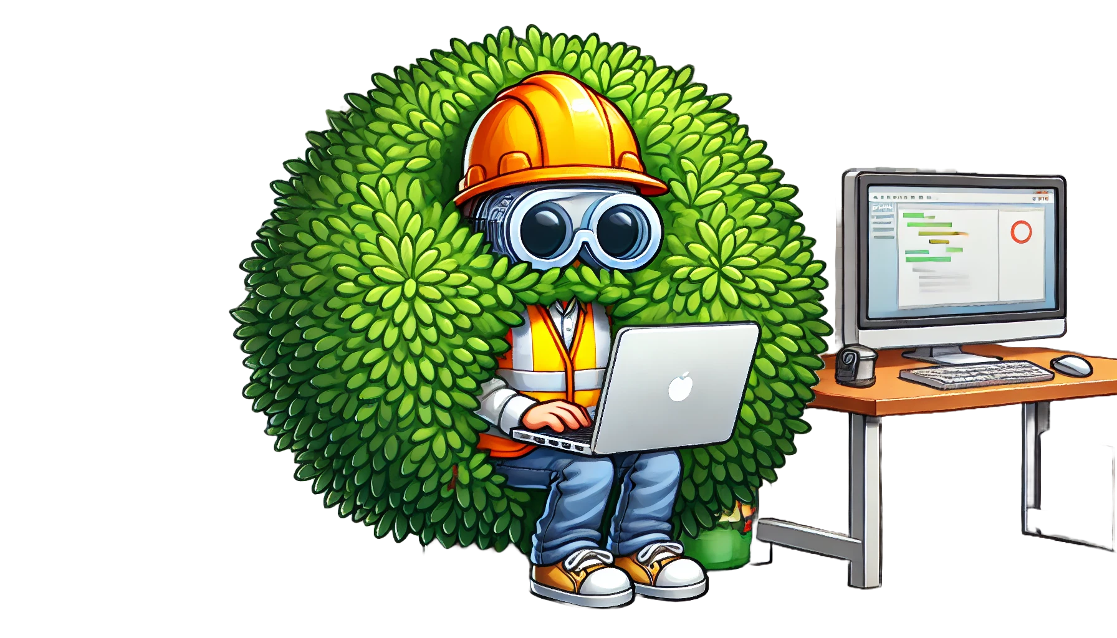
Be visible
Notes:
Generelle tips til å være synlig digitalt i arbeidslivet og introduksjon til github

Slide 12
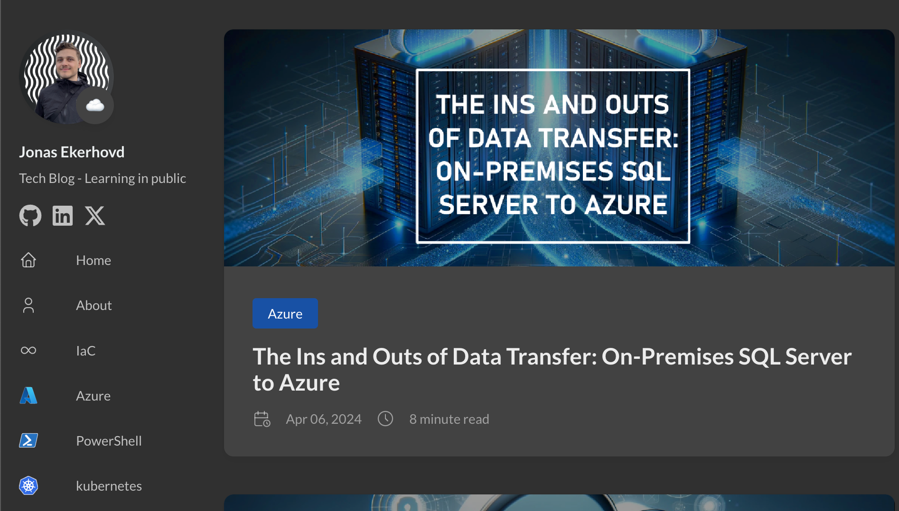
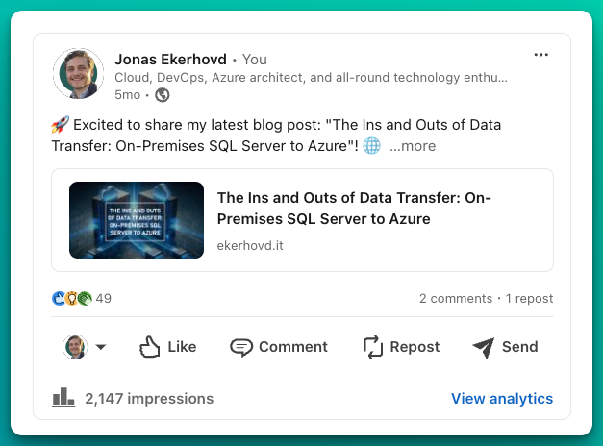
Control your own digital narrative
Use your real name
Learn in public
Share share share
Notes:
Share as much as you can- all the time
Some years ago, I spent a significant time going through (read: Googling myself) what existed of myself online. I ran a script to manually delete ALL my old facebook posts, and then disabled my account. I changed my Instagram handle, and removed all identifiable information. I was creating profiles with fake names, and I thought I was doing myself a favor in the name of privacy.
1. After my professional career I found myself torn between wanting to share what I have learned, and the feeling that it wasn't perfect enough to be publicly available. This takes time getting used to, but I recommend starting coming out of the digital wardrobe and at least post under your actual name.
2. You have probably heard it before. The best way to learn is to teach others. I wholeheartedly believe this to be true. There are many ways to teach a concept you've learned, or have just started learning, but it doesn't have to be more than a post on LinkedIn. My approach for this, is that I have started a tech blog. The deployment of this, was actually a learning journey in itself. This was set up using Hugo framework (taught me Markdown), hosted on Azure Static Web Apps (Taught me Cloud concepts) and continuously deployed using Github Actions (Taught me DevOps pipelines).
3. When you share personal struggles or insecurities in public, you might worry about appearing weak or flawed. However, observers often see such openness as a sign of authenticity and strength, leading to increased trust and connection. This is called the "Beautiful Mess Effect" and it's actually a psychological phenomenon.

Slide 13
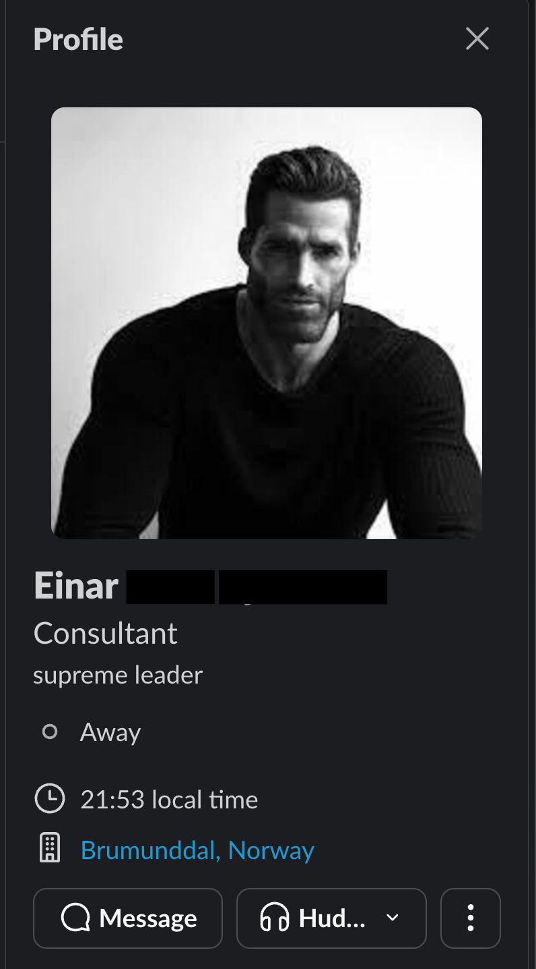
Profile Picture
Have at least 1 professional looking picture of yourself
Add it to EVERYTHING job related
Slack, Teams, Github, Workplace, LinkedIn
Don’t be this guy 👉

Slide 14
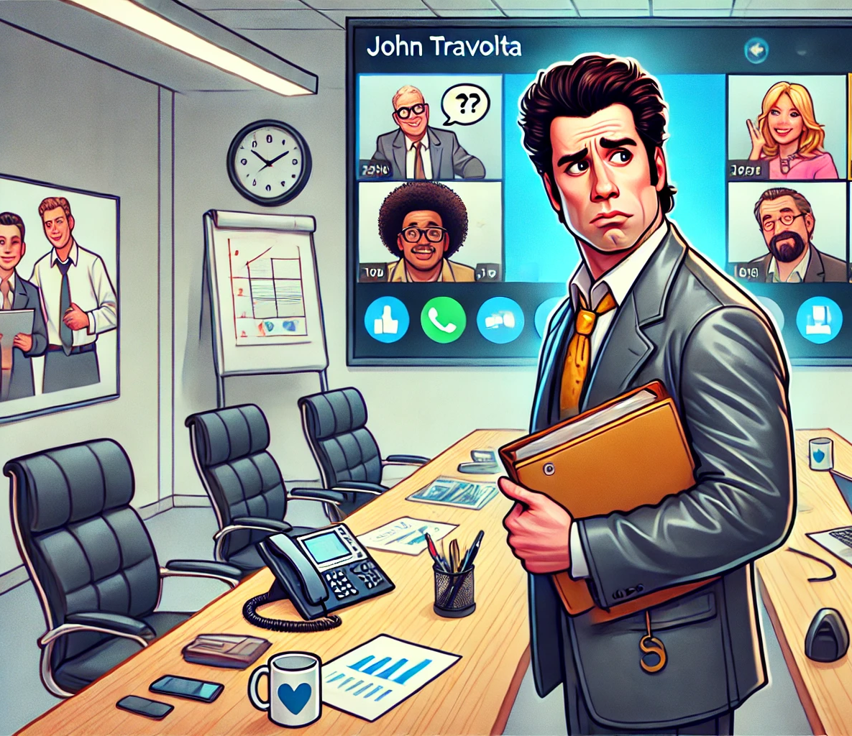
Camera on 🎥
Do yourself a favor
Turn your webcam ON at every digital meeting.
Notes:
I can't even begin to tell you about how many meeting I've been to, where the majority of attendees are muted and having their cameras turned off. I've even had colleagues I've worked with for 3 years and never knew how they really looked like.

Slide 15

Bonus Point 🌟🎯 The hawthorne effect
People will act differently (including yourself) if they know they are being observed.
Notes:
This might sound stupid but I tend to be at my most productive when I’m not totally alone. It helps to just have at least one other person watching, even if only one of you are working.
Since we work in mostly distributed teams, a good tip is to schedule a work call where you intend to get some work done, even if you are doing separate tasks.

Slide 16
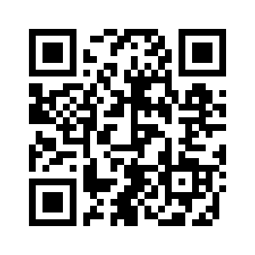
Exercise 1: Check your Social Selling Index (5 mins)
https://www.linkedin.com/sales/ssi
Notes:
Krever linkedin profil
Er det noen som er oppmot 100?
Har du over 20 så bør du vøre ok fornøyd

Slide 17
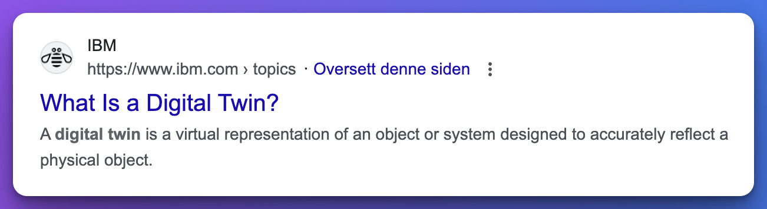
Why?
If Instagram is for showing off beach abs, GitHub is for flexing your tech muscles. Time to show those off! 💪
Notes:
I've always been fascinated by the technology term "Digital Twin". According to IBM it's a virtual representation of an object or system designed to accurately reflect a physical object. To me, it's the perfect analogy to what we're going to talk about today.
Your digital profile. If you think about it, you have two selves. Your real self, and your digital self. Your real self is the one in the driver's seat, taking all your decisions, doing all the work and experiences life. On the other hand, your digital self, is the set of footprints that you leave behind in the digital world. It's the one that is behind all your Instagram posts, the one that signs your e-mails, and lurks on Reddit.
Back to my example. The digital self I've kept with me that I am emphasizing today is my GitHub profile. All you need to know about social networking for developers is that GitHub won.

Slide 18
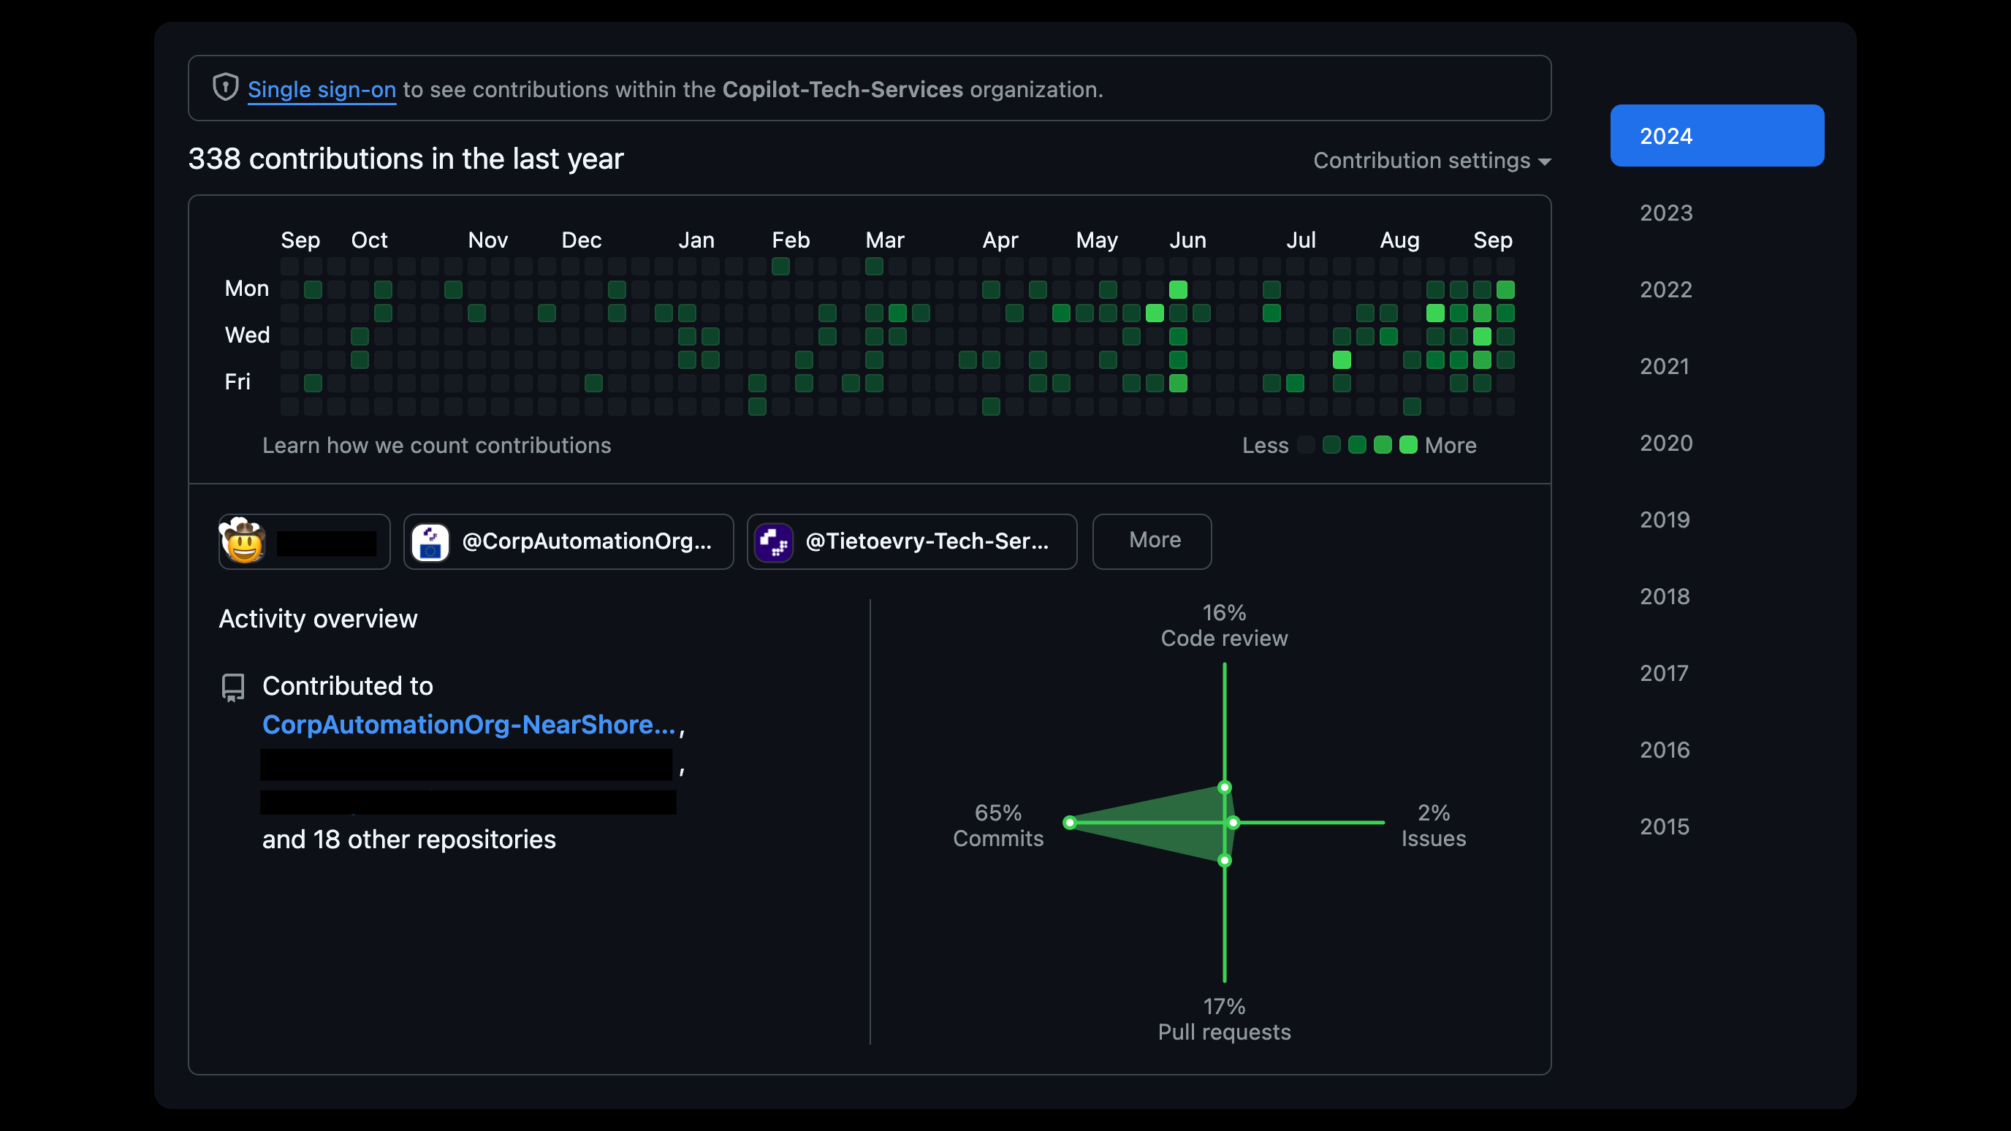
Notes:
Emphasize on the timeline of contributions here. This serves as a log of all your code related endeavors.

Slide 19
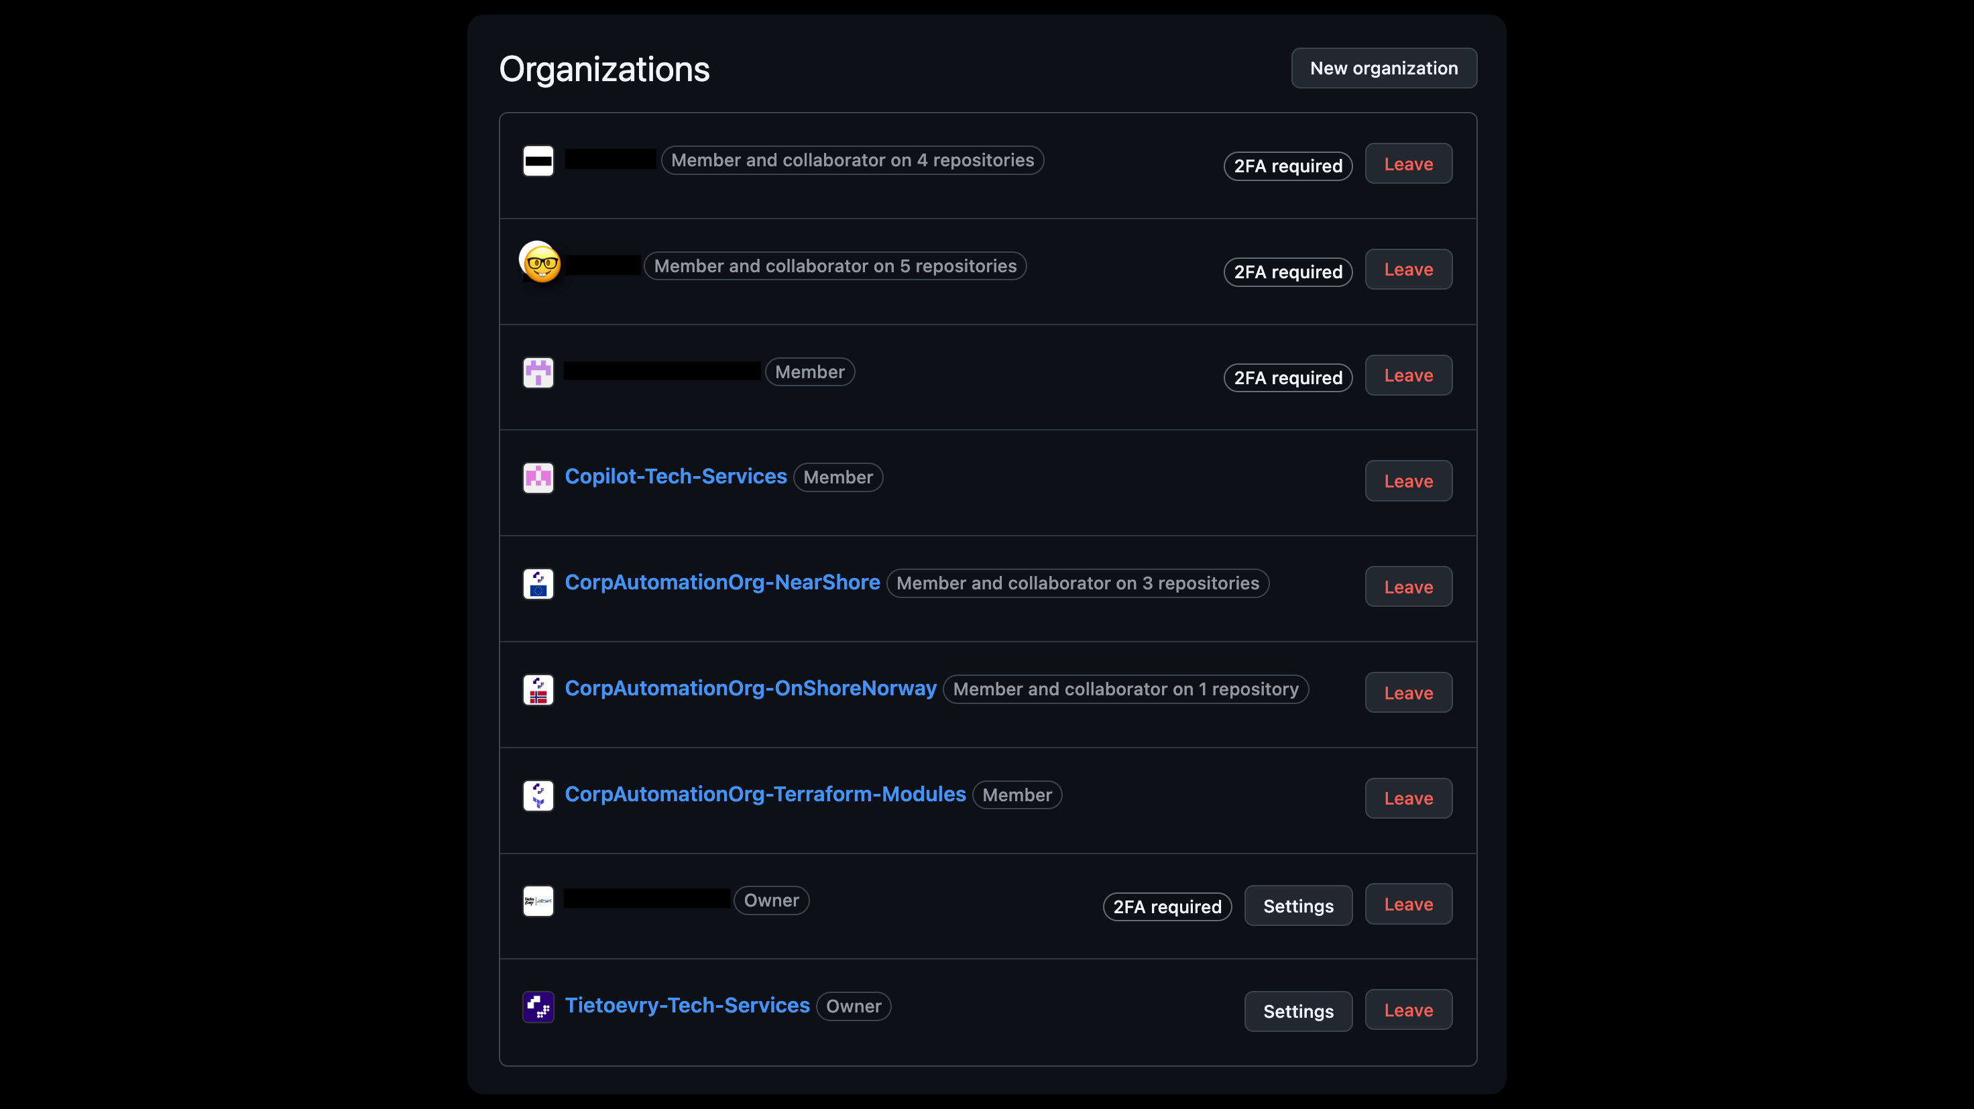
Notes:
Keep using your github account in any professional setting
I see many people creating new customer tailored profiles for every customer they work for. This is bad practice. The reasoning being that "I don't want to mix business and pleasure". That's bad practice.
Takeaway: You should always use the same github account across all the organizations you are going to be involved with. There's no need to create separate accounts for each customer.

Slide 20
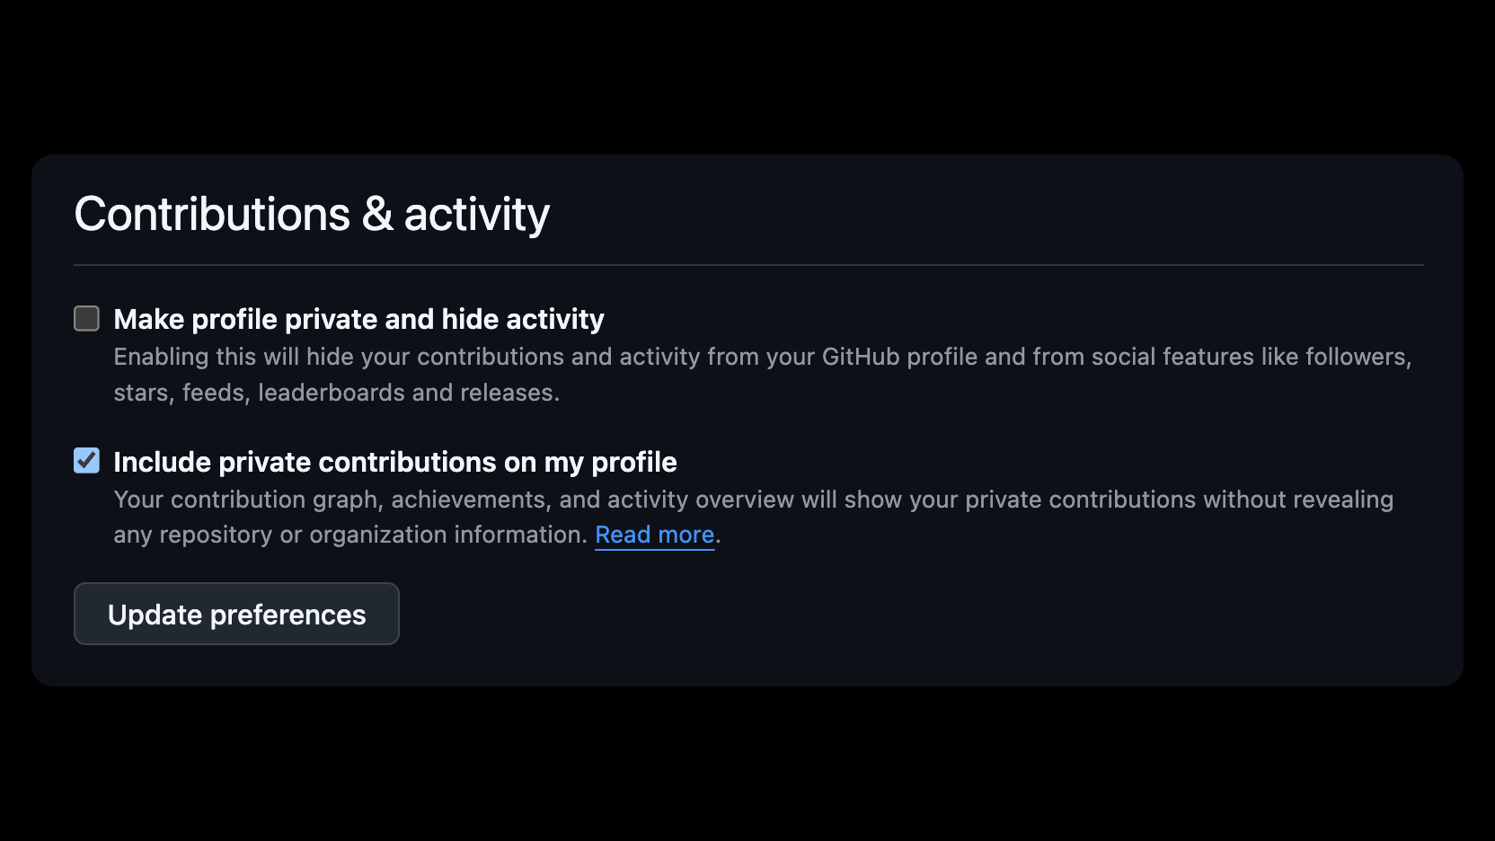
Notes:
Protip: Inside github profile -> Settings –> Scroll down to include private contributions on my profile. This will fill up your activity log even when working for private organizations or repositories.

Slide 21
Exercise 2 (20 min)
Enter github.com and create an account if you haven’t already
Enable 2FA (Profile -> Settings -> Password and authentication)
Create a repository with the same name as your GitHub Account
Update your readme.md
Make it ✨ pretty ✨
Notes:
Noen som var på workshop med Kantega «Hvordan bygge en god CV» klokken 12 ?
Dette er din Digitale CV for som tech rekrutterere faktisk bryr seg om?
No one reads a blank README.md file. It's like handing in a CV with your name and nothing else. Let’s fix that."

Slide 22
Exercise 3 (20 min) - follow along or DIY
Host your readme.md as a Github Page
https://docs.github.com/en/pages/quickstart
Change the Jekyll default theme (Optional)
https://github.com/pages-themes
Add your GitHub page to the featured section of LinkedIn
Protip: Purchase a custom domain to use instead of github.io
Notes:
Activity: Open up for any questions.
Offer to review GitHub profiles live if people are interested.
Thank attendees for sticking around and reiterate: "Your digital presence is more than just code – it’s your first impression."

Slide 23
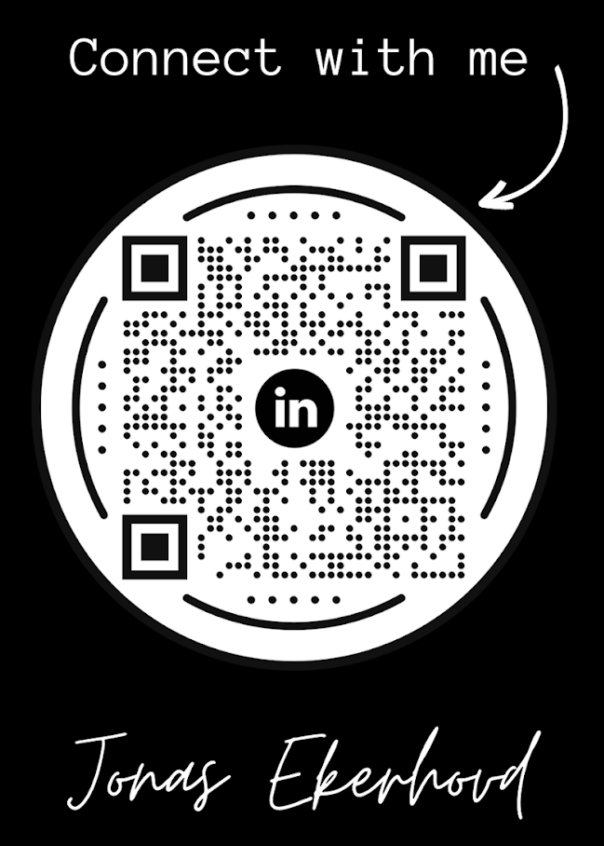
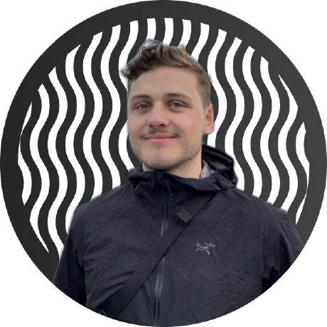
Thank you
Learn more at tietoevry.com

